Slide 1

PMI culture values & behaviors
For further information please email culture@pmi.org

Slide 2

PMI Culture Values
Make It Easy
We are easy to
deal with.
When things slow
us down, we find a better way.
We prioritize the impact that matters most and take the most direct route
to it.
Aim Higher
We set the standard in top quality work to create the greatest impact for the PMI community.
We lead the way by thinking long-term and acting in the short-term.
We fearlessly take ownership of what we do, knowing every action counts.
Be Welcoming
We create genuine belonging for all, because our differences make us stronger.
We act with humanity, showing care, empathy and respect for others’ needs.
We assume good intent and seek to understand, not judge.
Embrace
Curiosity
We are always seeking ways to better serve the PMI community.
We see challenges as opportunities to innovate, and take them.
We feel able to fail fast in order to get it right.
Together
We Can
We build deep, trusting relationships that help us work towards our mission together.
We use our shared purpose to unite us as a community and drive us forward to create impact.
We act in alignment with our global goals, while being empowered to deliver locally.

Slide 3
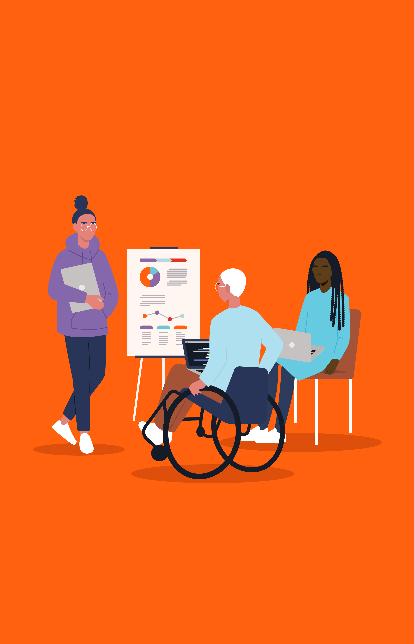
Make It Easy
We are easy to deal with.
When things slow us down, we find a better way.
We prioritize the impact that matters most and take the most direct route to it.
Behaviors:
I speak with candor and kindness to get to the right outcome quickly
I enable clear, simple and transparent communication and interaction that aligns with the needs of those involved
I reduce complexity and remove barriers wherever possible
I involve the right people in the right way
I act fast where possible, seek input where needed and have the experience and/or data to support my decisions
I say ‘no’ to some things, in order to be able to say ‘yes’ to the ones that matter most

Slide 4

Aim Higher
We set the standard in top quality work to create the greatest impact for the PMI community.
We lead the way by thinking long-term and acting in the short-term.
We fearlessly take ownership of what we do, knowing every action counts.
Behaviors:
I consistently deliver excellent experiences and work, and am always seeking ways to do better
I stay on top of industry trends and use these insights to drive even higher quality in what I do
I act quickly, sustainably and take smart risks, while being mindful of the long-term impact
I am self-aware and regularly seek out feedback, welcoming it as a route to personal growth
I have a bias for action and take responsibility for the outcome
I act ethically and with integrity, always following through on my commitments and trusting others to do the same

Slide 5
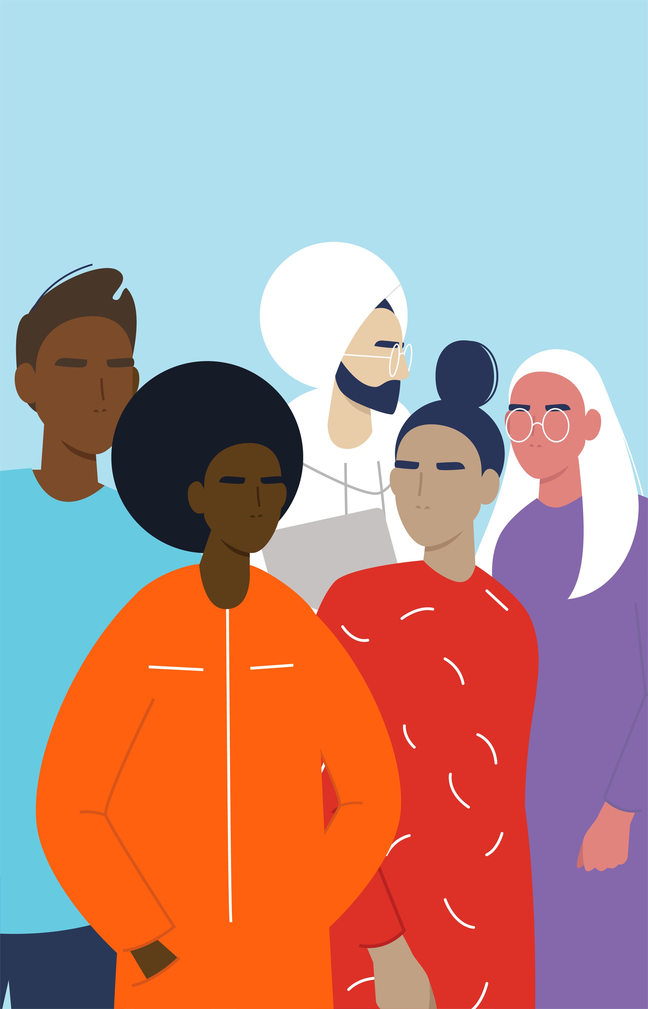
Be Welcoming
We create genuine belonging for all, because our differences make us stronger.
We act with humanity, showing care, empathy and respect for others’ needs.
We assume good intent and seek to understand, not judge.
Behaviors:
I speak out when there are instances of disrespect, bias, or discrimination
I create safe, supportive and respectful environments where we can all voice our needs, and every voice is heard
I am mindful of my own biases and background
I take time to understand others’ unique backgrounds, needs, experiences and perspectives
I empathize with others, see the best in them and find opportunities for us to succeed in partnership
I prioritize my own wellness and mental health, and make space for others to do the same

Slide 6

Embrace Curiosity
We are always seeking ways to better serve the PMI community.
We see challenges as opportunities to innovate, and take them.
We feel able to fail fast in order to get it right.
Behaviors:
I think critically and suggest solutions that could better meet the needs of the PMI community
I look beyond PMI to find new ways to create value and improve
I take the initiative and the responsibility for solving the problems I face
I stay open-minded, inquisitive and embrace opportunities to change
I create an environment where it’s safe to experiment and share mistakes, as a route to improving
I am constantly learning from others and recognize that there is always more than one possible ‘right’ path forward

Slide 7

Together We Can
We build deep, trusting relationships that help us work towards our mission together.
We use our shared purpose to unite us as a community and drive us forward to create impact.
We act in alignment with our global goals, while being empowered to deliver locally.
Behaviors:
I build personal relationships that last, not just connections
I listen to understand, and find ways to collaborate on solutions
I celebrate successes and learnings, so we can all grow and move forward faster
I support those around me, knowing that I can only succeed if we all succeed
I give freedom within a clear framework, offering meaningful empowerment
I consider the impact of my actions on all members of the PMI community, and act to create the best overall outcome in service of our mission

Slide 8

PMI Culture Values & Behaviors
Make It Easy
Aim Higher
Be Welcoming
Embrace Curiosity
Together We Can
We are easy to deal with.
When things slow us down, we find a better way.
We prioritize the impact that matters most and take the most direct route to it.
Behaviors:
I speak with candor and kindness to get to the right outcome quickly
I enable clear, simple and transparent communication and interaction that aligns with the needs of those involved
I reduce complexity and remove barriers wherever possible
I involve the right people in the right way
I act fast where possible, seek input where needed and have the experience and/or data to support my decisions
I say ‘no’ to some things, in order to be able to say ‘yes’ to the ones that matter most
We set the standard in top quality work to create the greatest impact for the PMI community.
We lead the way by thinking long-term and acting in the short-term.
We fearlessly take ownership of what we do, knowing every action counts.
Behaviors:
I consistently deliver excellent experiences and work, and am always seeking ways to do better
I stay on top of industry trends and use these insights to drive even higher quality in what I do
I act quickly, sustainably and take smart risks, while being mindful of the long-term impact
I am self-aware and regularly seek out feedback, welcoming it as a route to personal growth
I have a bias for action and take responsibility for the outcome
I act ethically and with integrity, always following through on my commitments and trusting others to do the same
We create genuine belonging for all, because our differences make us stronger.
We act with humanity, showing care, empathy and respect for others’ needs.
We assume good intent and seek to understand, not judge.
Behaviors:
I speak out when there are instances of disrespect, bias, or discrimination
I create safe, supportive and respectful environments where we can all voice our needs, and every voice is heard
I am mindful of my own biases and background
I take time to understand others’ unique backgrounds, needs, experiences and perspectives
I empathize with others, see the best in them and find opportunities for us to succeed in partnership
I prioritize my own wellness and mental health, and make space for others to do the same
We are always seeking ways to better serve the PMI community.
We see challenges as opportunities to innovate, and take them.
We feel able to fail fast in order to get it right.
Behaviors:
I think critically and suggest solutions that could better meet the needs of the PMI community
I look beyond PMI to find new ways to create value and improve
I take the initiative and the responsibility for solving the problems I face
I stay open-minded, inquisitive and embrace opportunities to change
I create an environment where it’s safe to experiment and share mistakes, as a route to improving
I am constantly learning from others and recognize that there is always more than one possible ‘right’ path forward
We build deep, trusting relationships that help us work towards our mission together.
We use our shared purpose to unite us as a community and drive us forward to create impact.
We act in alignment with our global goals, while being empowered to deliver locally.
Behaviors:
I build personal relationships that last, not just connections
I listen to understand, and find ways to collaborate on solutions
I celebrate successes and learnings, so we can all grow and move forward faster
I support those around me, knowing that I can only succeed if we all succeed
I give freedom within a clear framework, offering meaningful empowerment
I consider the impact of my actions on all members of the PMI community, and act to create the best overall outcome in service of our mission

